Slide 1
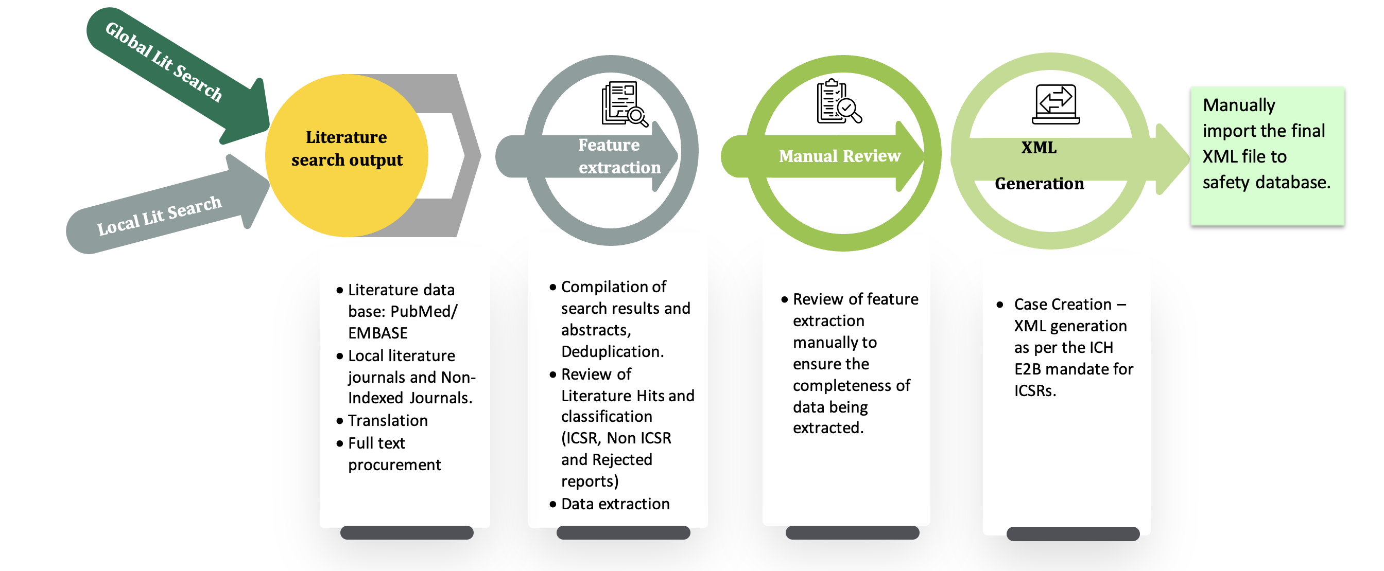

Slide 2

How our Product Aligns to the Flow

Slide 3
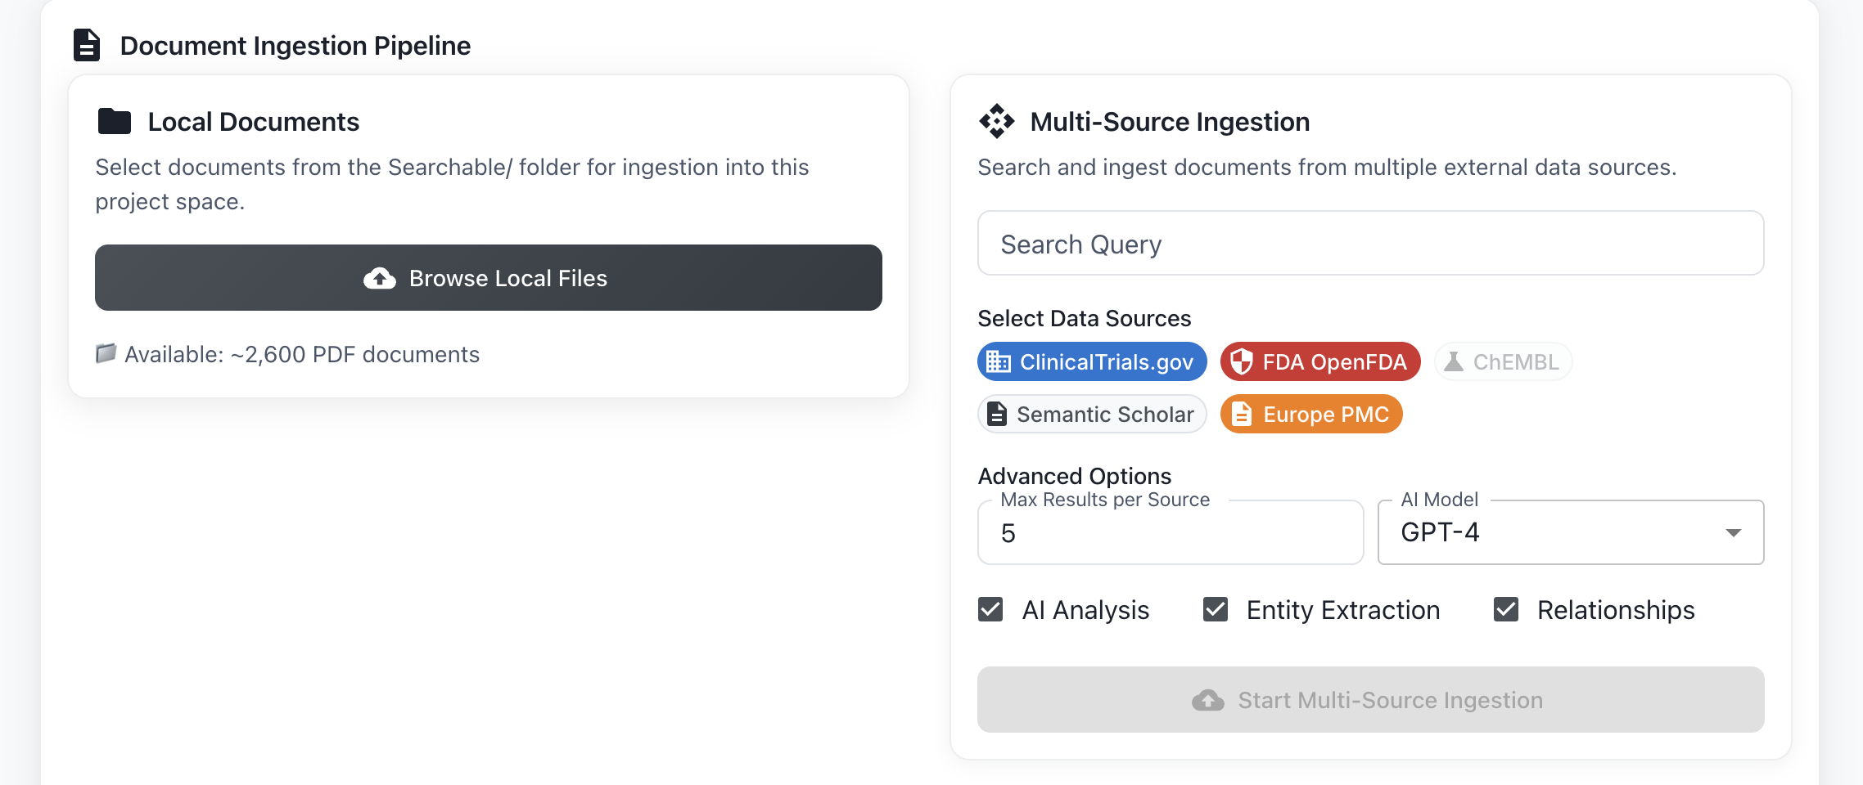
Local Ingestion
Configurable Multisource Ingestion
In-build models for extracting Entities ,
Relationships

Slide 4
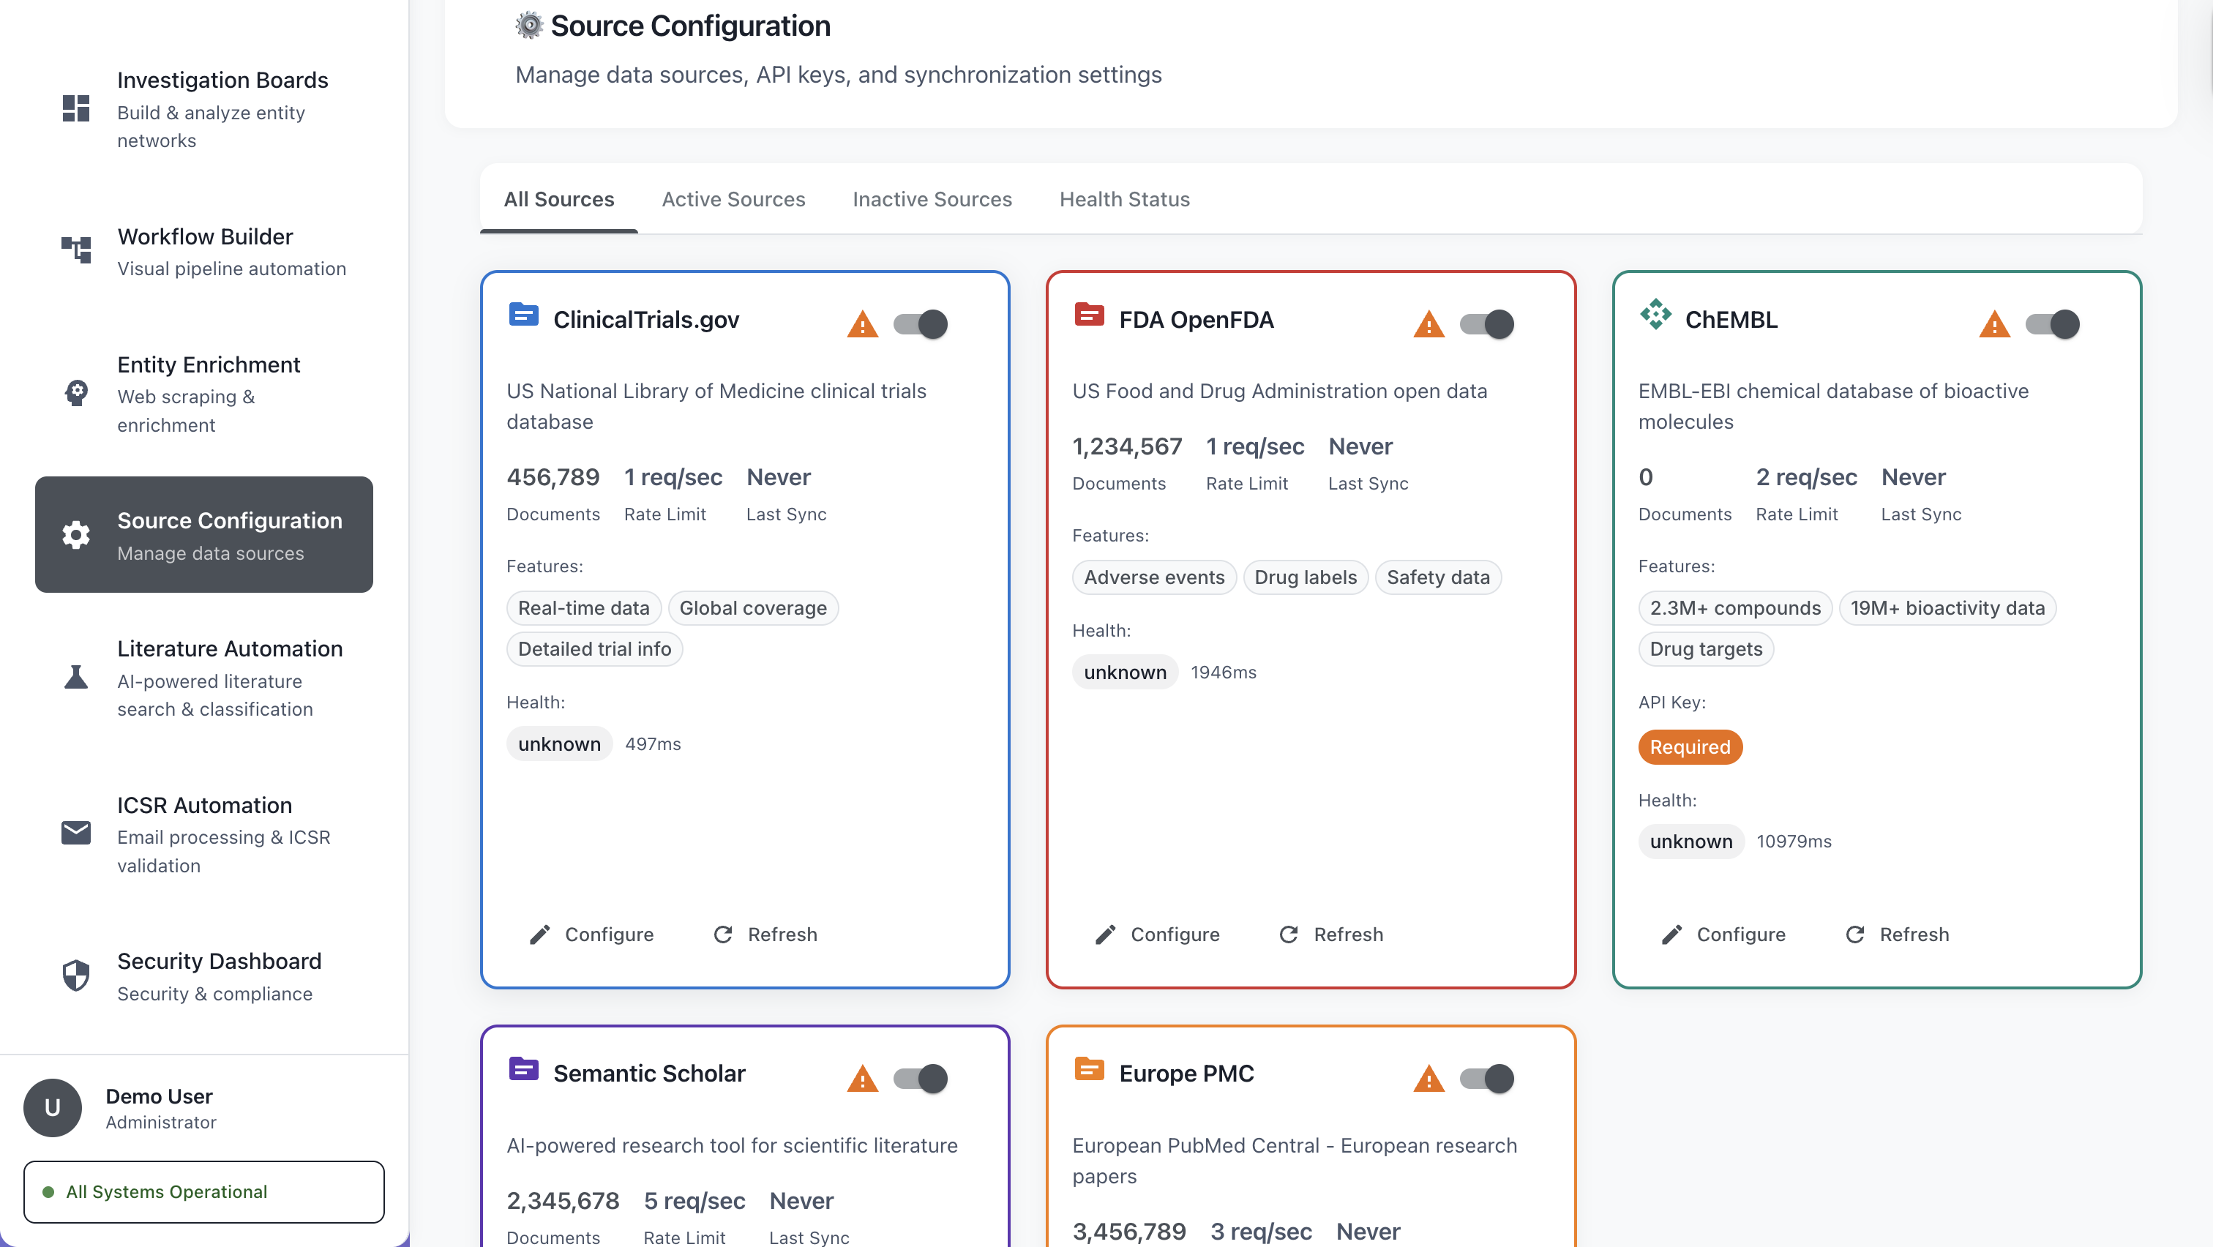
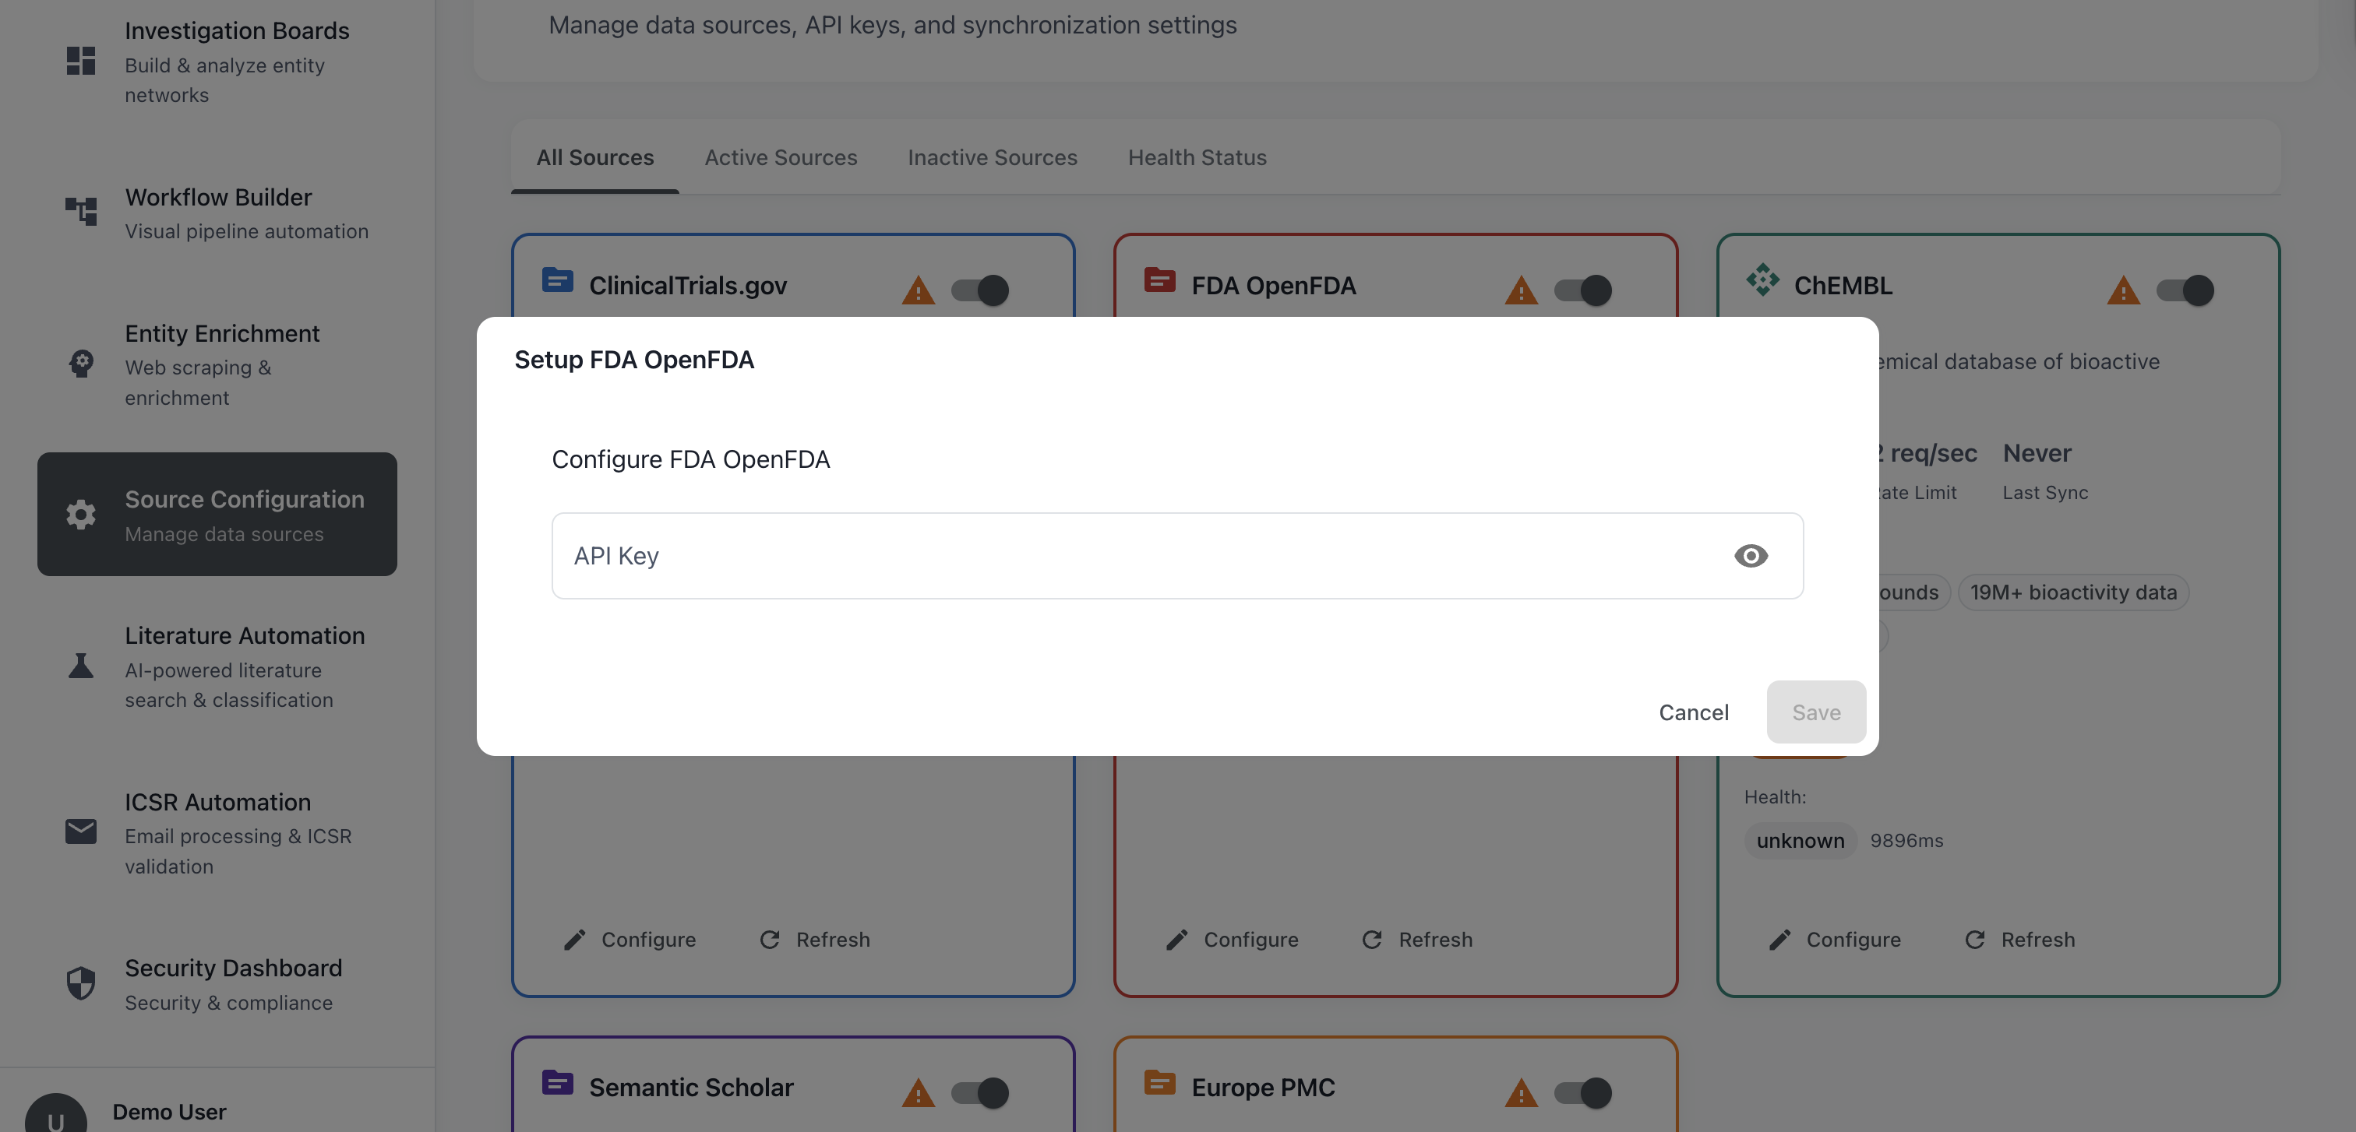
Custom Source Configuration, Bring Any APIs

Slide 5
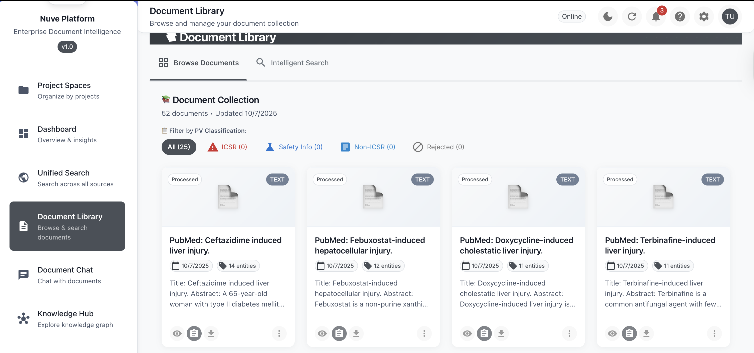

Slide 6
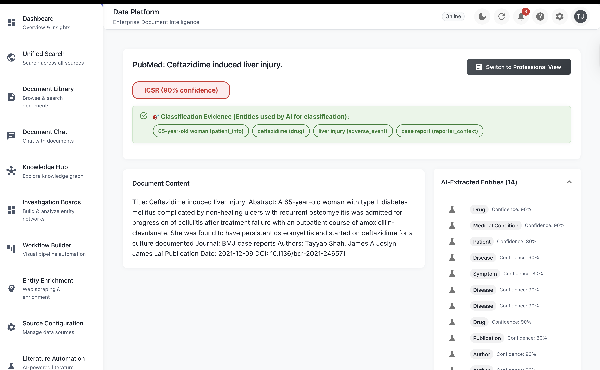
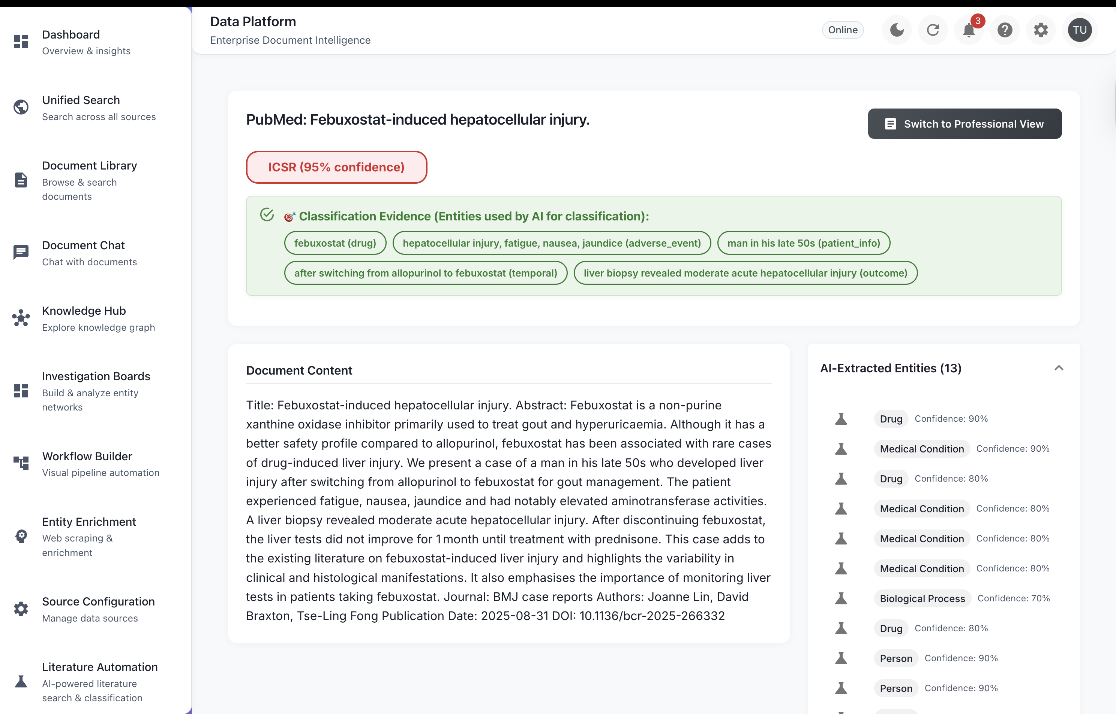

Slide 7
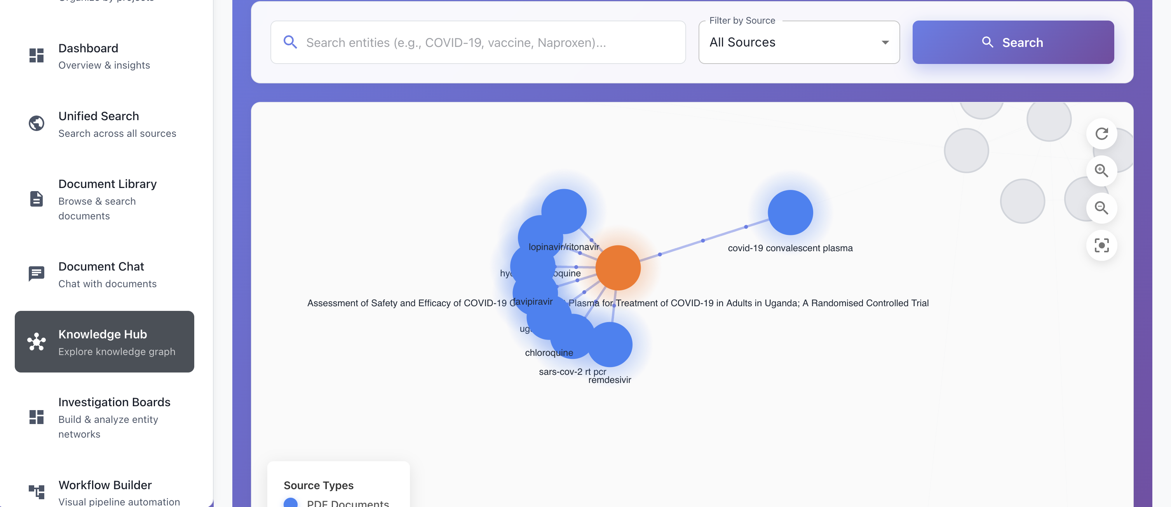
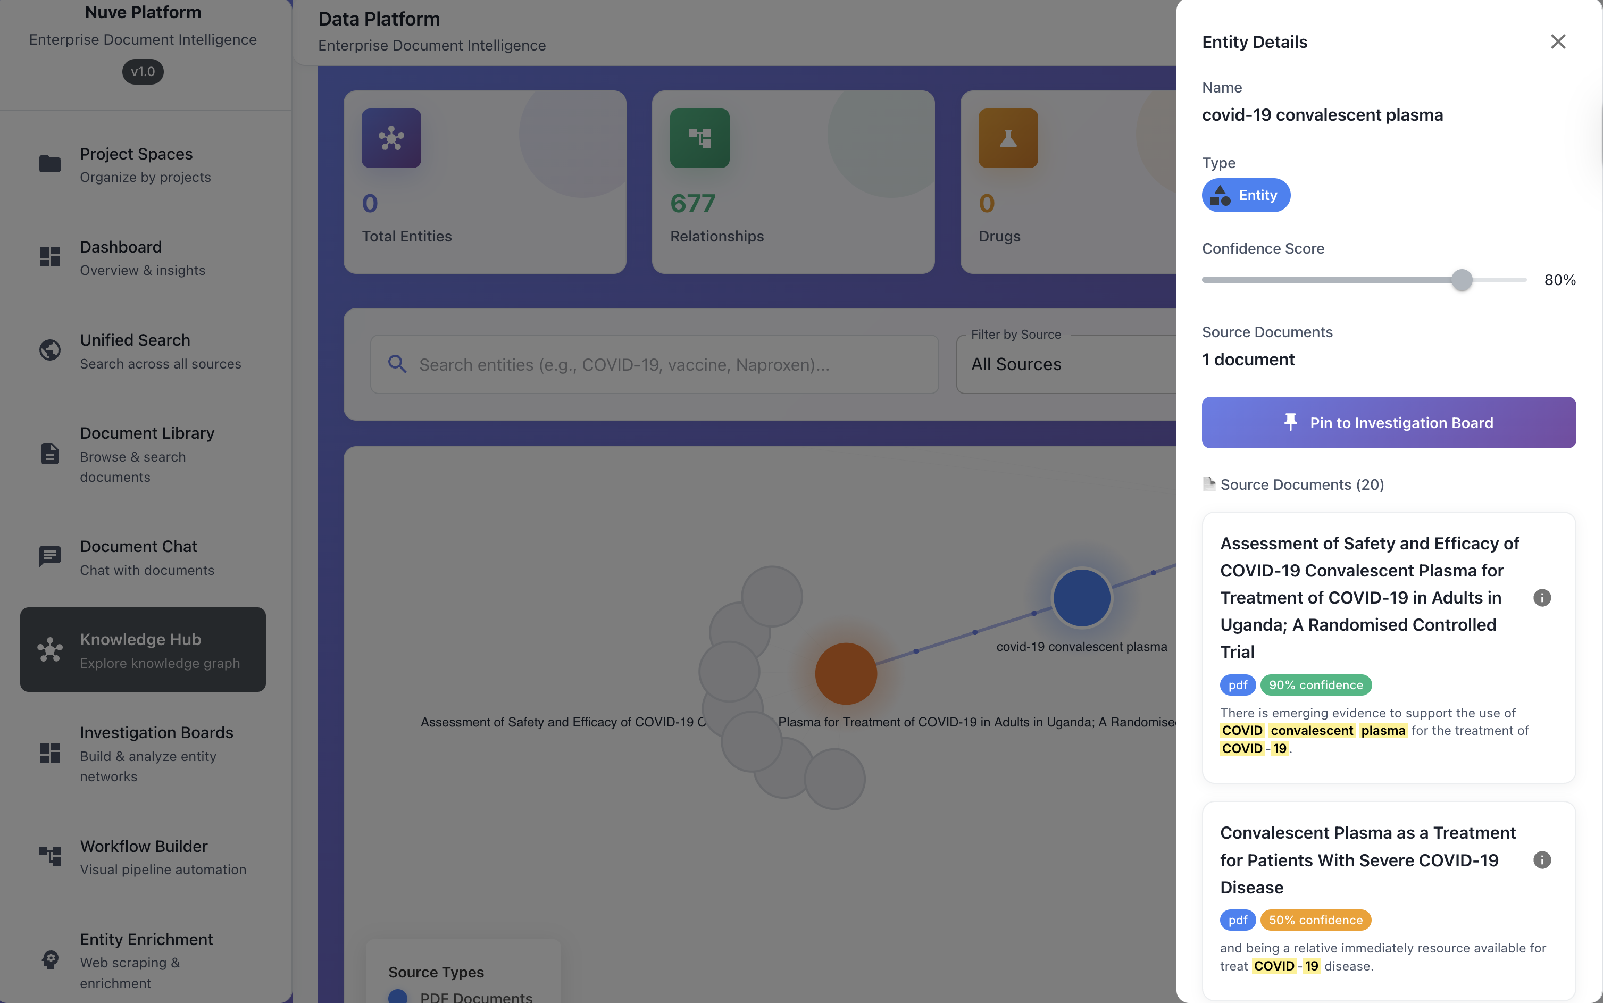
Extracted information in connected format in Knowledge Hub
Node drilldown capability , pin the information to your Investigation Board
Get all Documents with particular entity
Chat feature with only the selected documents

Slide 8
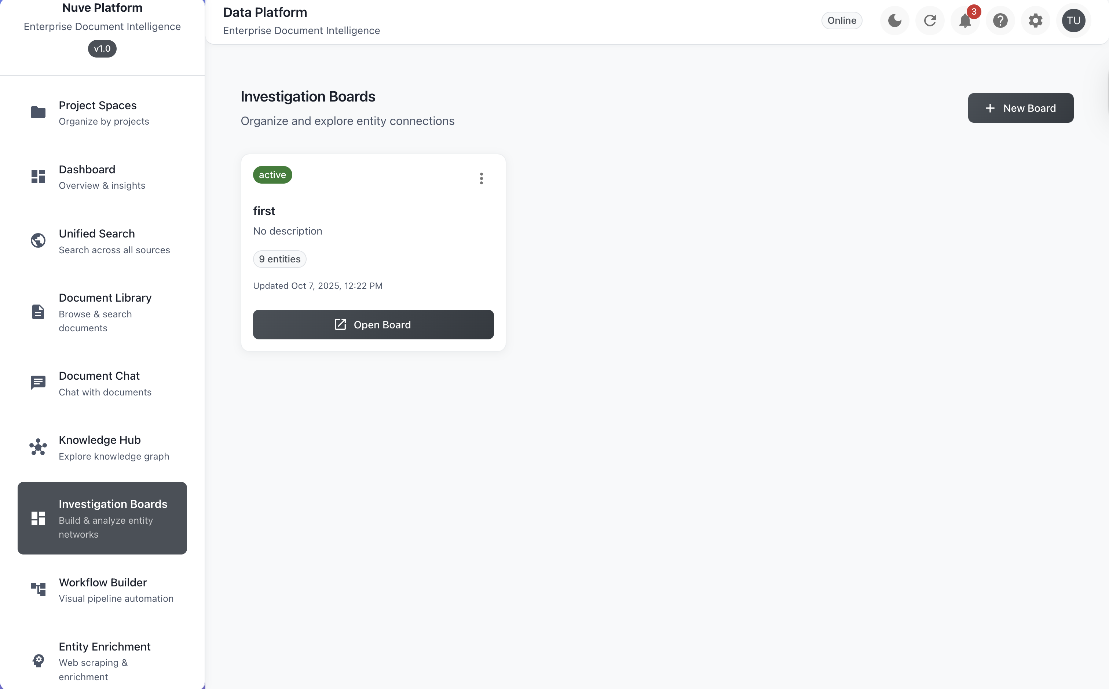
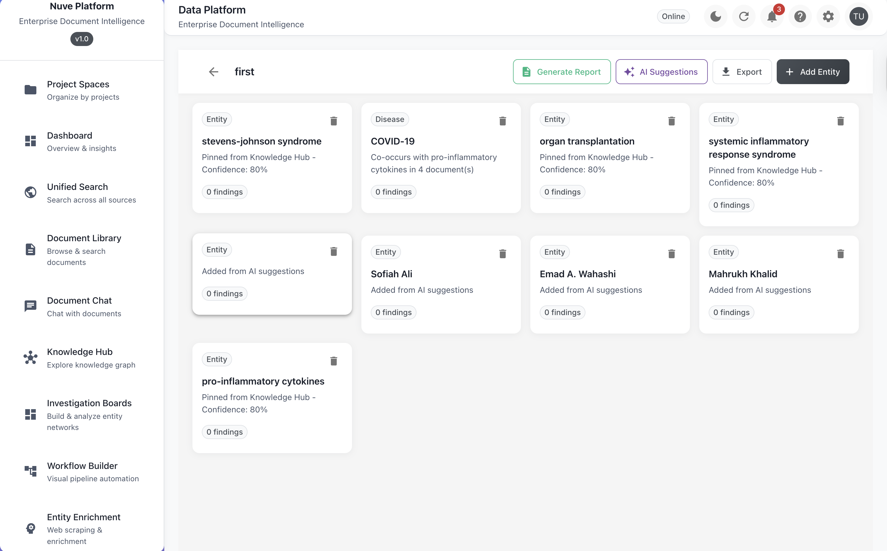

Slide 9
